Slide 1
Quick overview of OpenMP
OpenMP workshop
erhtjhtyhy
Jose Monsalve
April 26th 2019 – Chicago IL

Slide 2
Overview
An introduction to OpenMP
OpenMP Programming model
Directives and clauses
OpenMP Memory Model
Directives and clauses
Tasking Model

Slide 3
The OpenMP Programming Model

Slide 4
FORK AND JOIN Model
Parallel regions
Execution starts with a single thread.
#pragma omp parallel spanws multiple threads
At the end of the parallel region execution returns to a single thread (Barrier)

Slide 5
FORK AND JOIN Model
Definitions of threads
There is always a master threads
User controls code and data distribution
OMP_NUM_THREADS environmental var
The number of threads can be controlled
omp_set_num_threads() API call
num_threads() clause

Slide 6
Review of OpenMP directives

Slide 7
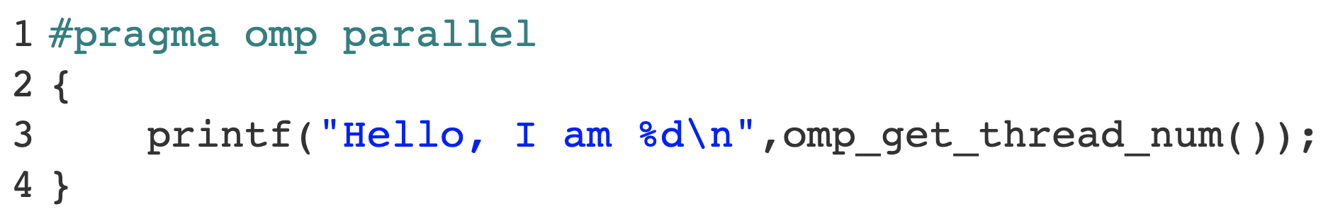
FORK AND JOIN Model
Same code is executed by all the threads
Each thread has its own identifier
There is private and shared memory
Unless nowait clause is used, there is a barrier at the end of the parallel region
Parallel directive

Slide 8
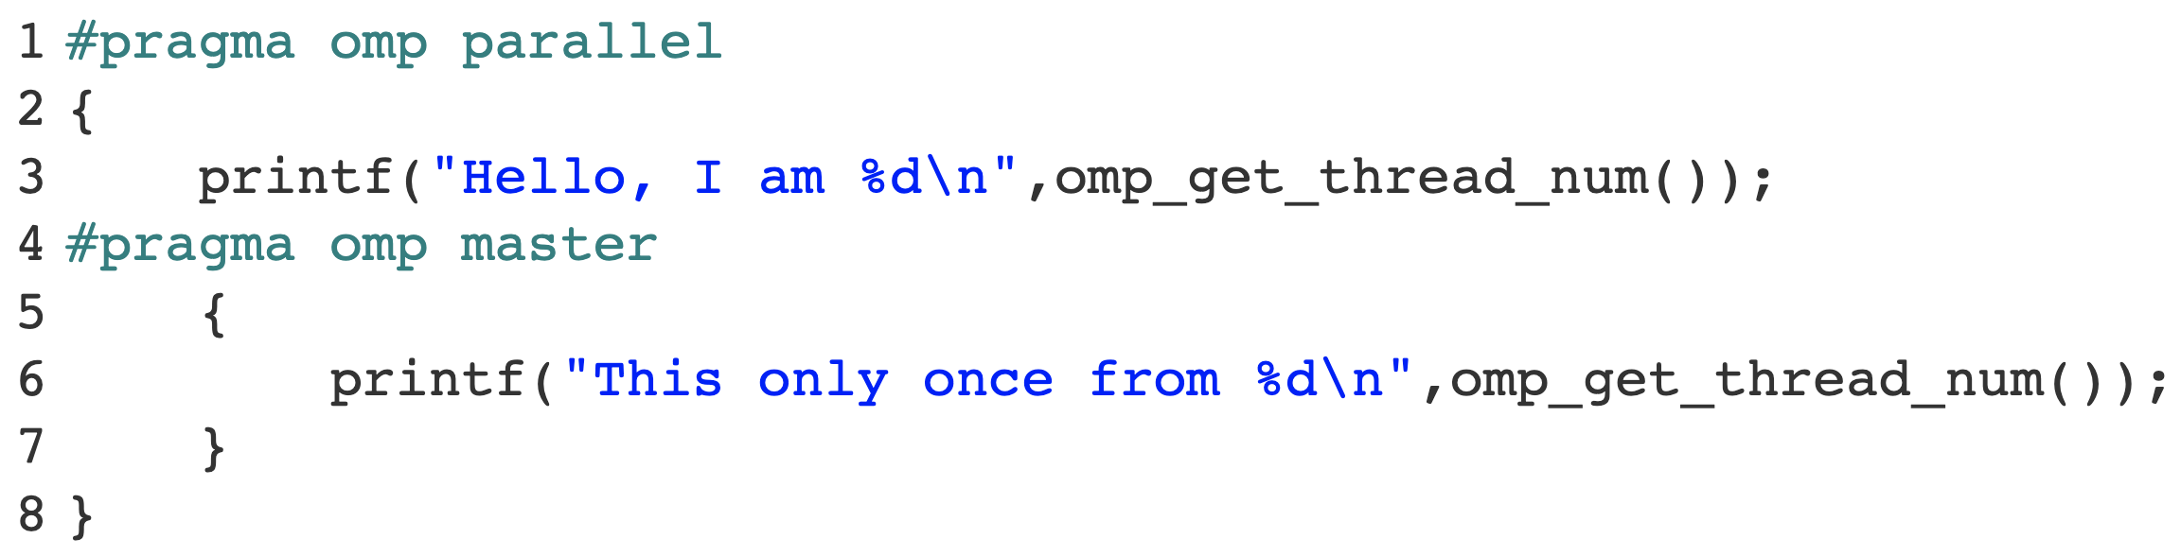
FORK AND JOIN Model
Master directive
All the threads execute the parallel region
But only the master threads execute line 6
There is no barrier at the end of the master region

Slide 9
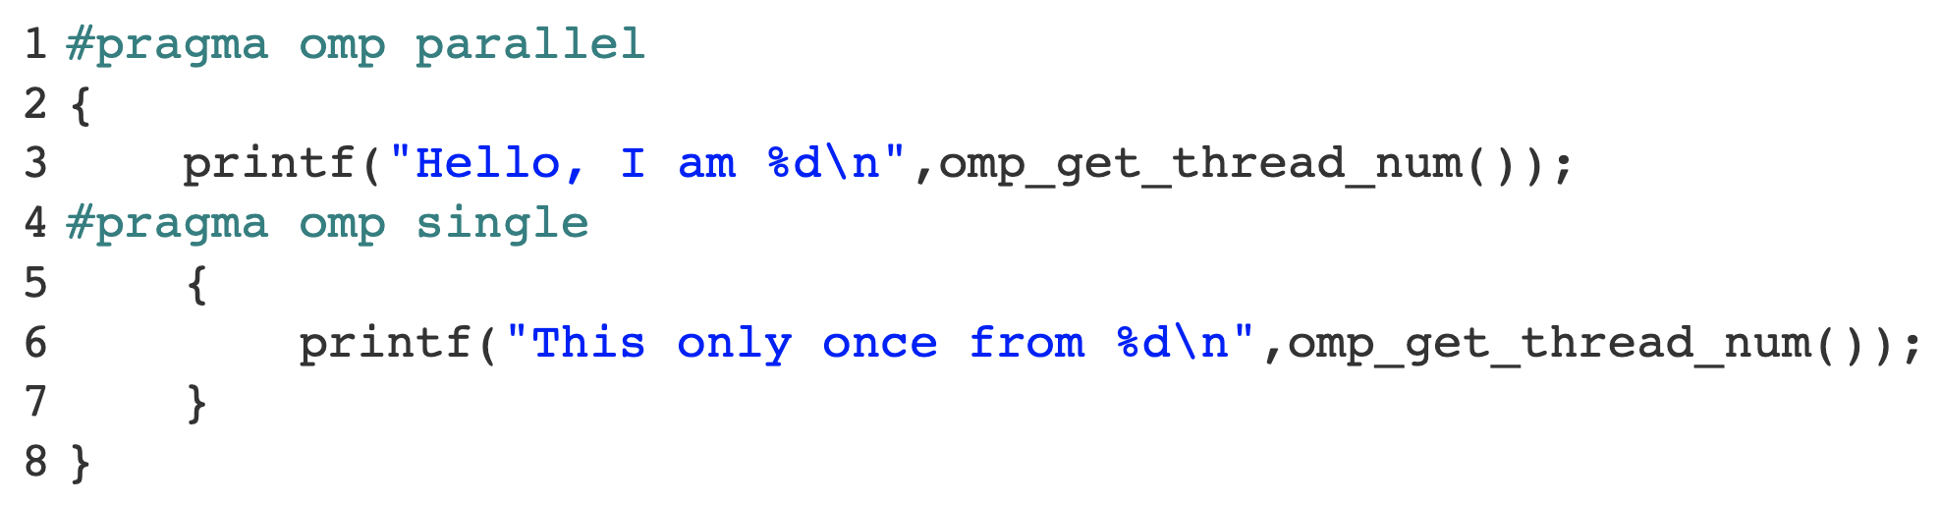
FORK AND JOIN Model
Single directive
All the threads execute the parallel region
But only the a single threads execute line 6
It can be a thread different than the master
Unless nowait clause, there is a barrier after the single region

Slide 10
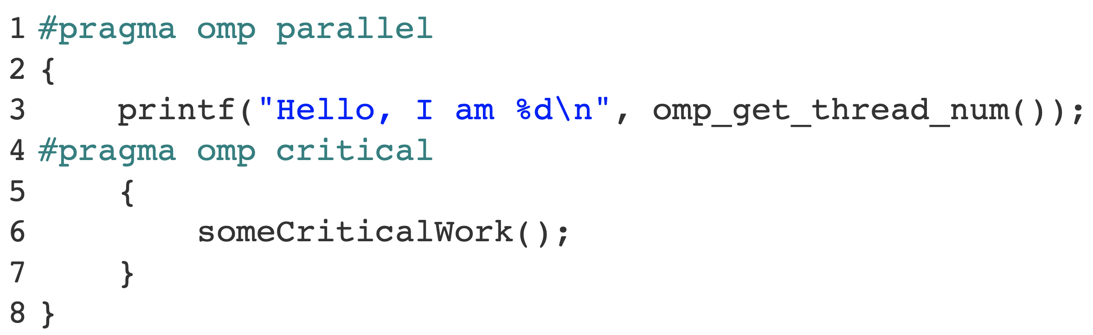
FORK AND JOIN Model
Critical directive
All the threads access the critical region at some point
But only a single threads at a time executes the thread unsafe work at line 5
Guarantees mutual exclusion

Slide 11
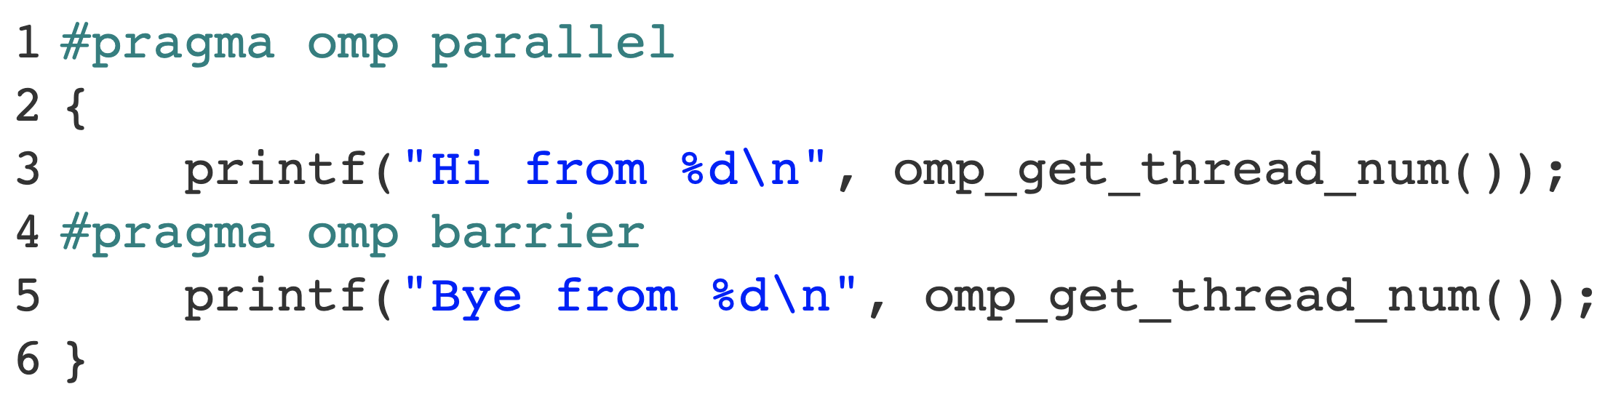
FORK AND JOIN Model
Barrier directive
Global synchronization of threads
All the threads executed all the work before the barrier, and wait for everyone to reach it.
All “hi from” messages should be printed before all “bye from” messages

Slide 12
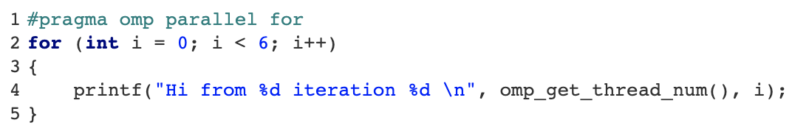
FORK AND JOIN Model
Parallel for/do loop directive
Iteration space:
i = 0
Loop is executed in parallel
Each thread gets a chunk of the iteration space
How to distribute the iterations?
i = 1
i = 2
i = 3
i = 4
i = 5

Slide 13
FORK AND JOIN Model
Parallel for/do loop directive
Iteration space:
i = 0
Loop is executed in parallel
Each thread gets a chunk of the iteration space
How to distribute the iterations?
A: schedule() clause
i = 1
i = 2
i = 3
i = 4
i = 5

Slide 14
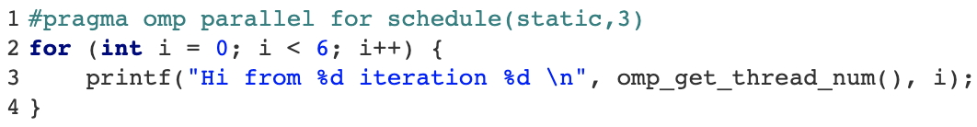
FORK AND JOIN Model
Parallel for/do loop – Scheduling of the iteration space
Iteration space:
Chunk 0
Compilation time:
(dynamic)
Chunk size is static.
Assignment of chunks per threads is dynamic
Chunk 1
Chunk 2
Chunk 3
Chunk 4
Chunk 5
Chunk 6
...
…
…
Chunk 7
Chunk M

Slide 15
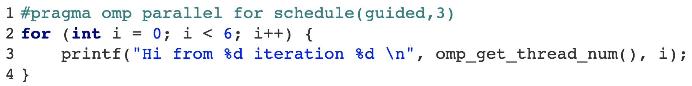
FORK AND JOIN Model
Parallel for/do loop – Scheduling of the iteration space
Iteration space:
Chunk 0
Compilation time:
(guided)
Chunk size is dynamic.
Assignment of chunks per threads is dynamic
Chunk 1
Chunk 2
Chunk 3
...
…
…
Chunk 4
Chunk M

Slide 16
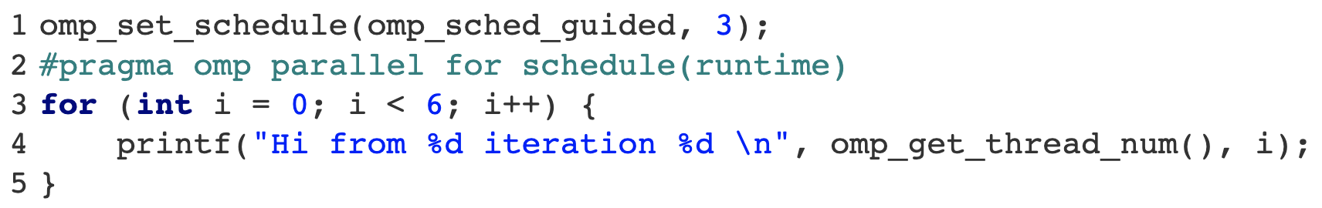
FORK AND JOIN Model
Parallel for/do loop – Scheduling of the iteration space
Iteration space:
Chunk 0
(runtime)
Decided at runtime through the: run-sched-var
(auto)
Decision delegated to the compiler and/or runtime
Chunk 1
Chunk 2
Chunk 3
...
…
…
Chunk 4
Chunk M

Slide 17
OpenMP Memory model and clauses

Slide 18
The OpenMP Memory Model
Global shared vs thread local memory
Global Shared Memory Space
Thread Local Memory Space
Thread Local Memory Space
Thread Local Memory Space
Seen only by itself
Private to each thread
Thread Local Memory Space
Seen by all threads

Slide 19
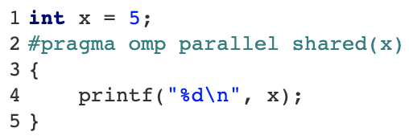
OpenMP Memory clauses
Shared() clause
Global Shared Memory Space
X = 5
Thread Local Memory Space
Thread Local Memory Space
Thread Local Memory Space
Thread Local Memory Space

Slide 20
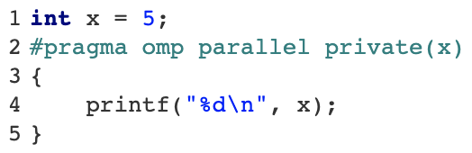
OpenMP Memory clauses
Private() clause
Global Shared Memory Space
X = 5
Thread Local Memory Space
X = ??
Thread Local Memory Space
X = ??
Thread Local Memory Space
X = ??
Thread Local Memory Space
X = ??

Slide 21
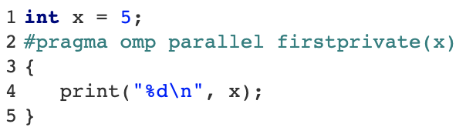
OpenMP Memory clauses
firstprivate() clause
Global Shared Memory Space
X = 5
Thread Local Memory Space
X = 5
X = 5
X = 5
X = 5
X = 5
Thread Local Memory Space
X = 5
Thread Local Memory Space
X = 5
Thread Local Memory Space
X = 5

Slide 22
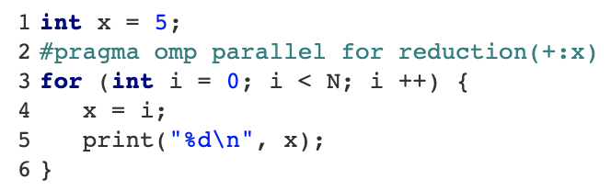
OpenMP Memory clauses
reduction() clause
Global Shared Memory Space
X = 5
Thread Local Memory Space
X = N*(N-1)/2
X = 0
X = 0
Thread Local Memory Space
X = 1
X = 1
+
X = N*(N-1)/2
Thread Local Memory Space
X = 2
X = 2
Thread Local Memory Space
X = N-1
X = N-1

Slide 23
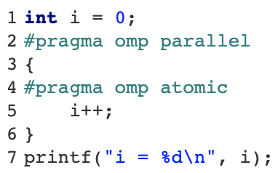
OpenMP Memory clauses
Atomic Directive
Global Shared Memory Space
Thread Local Memory Space
X = 4
X = 3
X = 2
X = 1
X = 0
Thread Local Memory Space
Thread Local Memory Space
Thread Local Memory Space
Notes:
Change the line 4 to have omp atomic

Slide 24
TASKING

Slide 25
Tasking in OpenMP
Yet another way of assigning work to threads…
Before tasking we used worksharing constructs to assign work to threads:
For/do loops, sections, single …
Tasks allow us to create and queue “work” that threads execute
Additionally it allows controlling dependencies between different work tasks
We use a parallel region to create the threads, and the tasking constructs to create work and add it into the work queue

Slide 26
Tasking Model
Task definition
TASK
A task is an instance of executable code and its data environment.
A task is generated by:
Task
Taskloop
Parallel (implicitly)
Target (implicitly)
Teams (implicitly)
Tasking constructs provide units of work to a thread for execution.
Task data environment:
x y
Task Region (Code):
int y;
printf("Hi from %d\n", \
omp_get_thread_num());
int x = 10;
#pragma omp parallel
{
#pragma omp task
{
int y = x;
printf("Hi from %d\n", \
omp_get_thread_num();
}
}

Slide 27
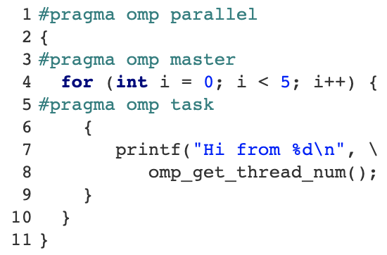
Tasking Model
Creation of tasks
Note: The number of workers is determined by the number of threads in the parallel region
Task queue

Slide 28
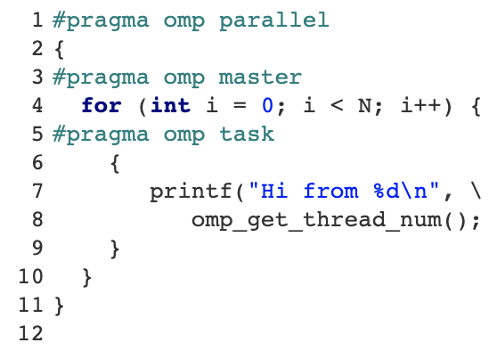
Tasking Model
Oversubscription of tasks
Task queue

Slide 29
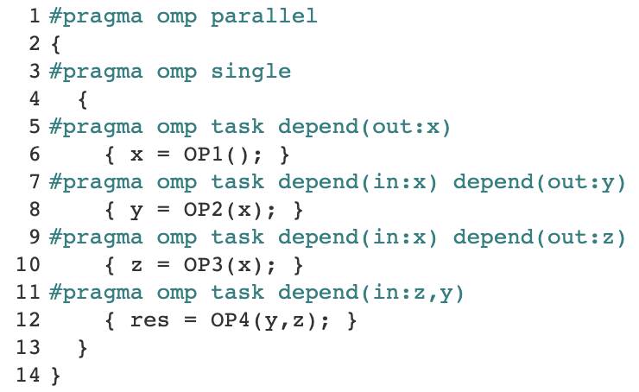
Task dependencies
Give order to task execution
OP1()
Predecessor task
x
x
Dependent task
OP2()
OP3()
OP1
y
z
OP2
OP4()
OP3
Dependencies guarantees order between tasks if the variable belongs to the same data environment
OP4

Slide 30
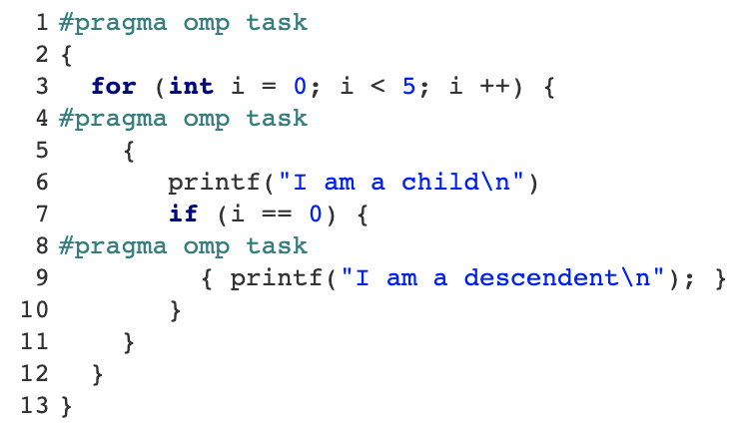
Tasking Model
Terminology
T1
Child tasks
CHILDREN OF T1
Descendent tasks
DESCENDENT OF T1
Sibling tasks
CREATE TASK
*not dependency

Slide 31
Tasking Model
Task Scheduling Points
Task execution can be suspended and resumed later on.
This can only happen at certain points called scheduling points.
Some examples:
Generation of the task
Taskyield directive
Taskwait directive
End of taskgroup directive
Implicit and explicit barriers
suspended
Resumed
T
T
Task queue

Slide 32
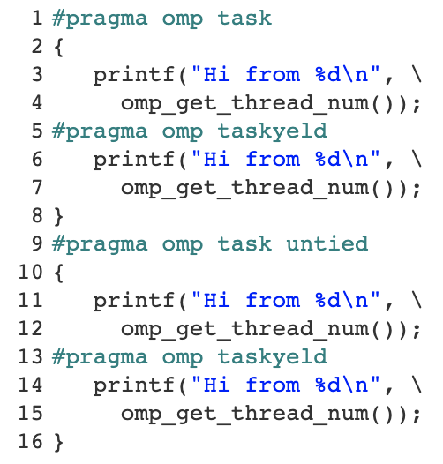
Tasking Model
Tied and Untied tasks
Task queue
Tied: Can be resumed only by the same thread that suspended it
Untied: Can be resumed by any thread in the team

Slide 33
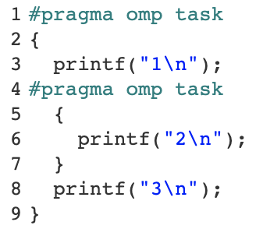
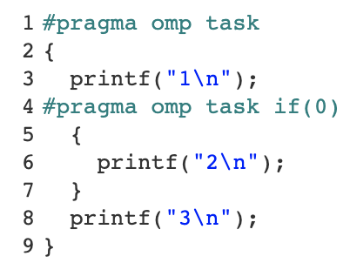
Tasking Model
Deferred and Undeferred tasks
Deferring a task means that a task is generated but not executed right away without suspending the execution of the generating (current) task
A task is deferred by default
A non deferred task suspends the execution of the current task until the generated task gets executed
Deferred
Undeferred

Slide 34
Tasking Model
Included, merged, and final tasks
Included task: A task for which execution is sequentially included in the generating task region.
Undeferred and executed immediately
Merged task: A task for which the data environment and Internal Control Variables is the same as the generating task
Must be undeferred and included
Final Task: A task that forces all of its child tasks to become final and included. Recursively make all descendant tasks included as well
It does not merge the tasks, unless allowed by each task (i.e. mergeable clause)

Slide 35
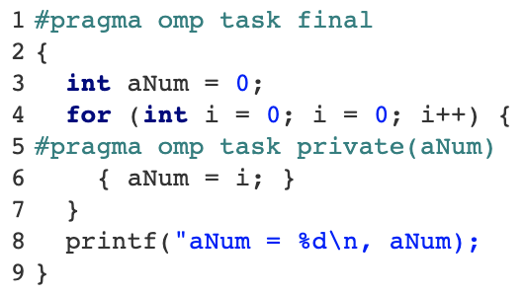
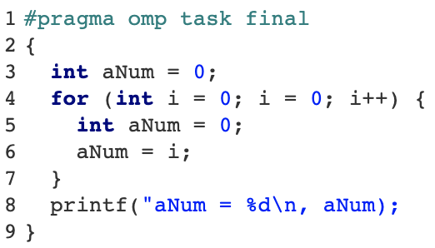
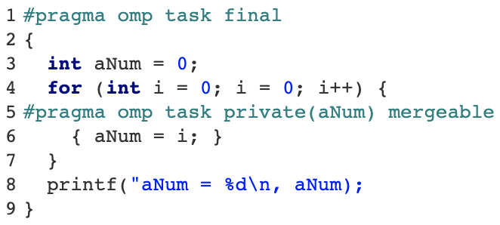
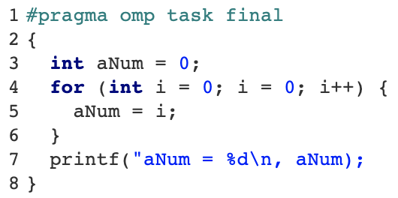
Tasking Model
Final tasks
(1)
(1)
Equivalent to
Either way
(1)
(1)

Slide 36
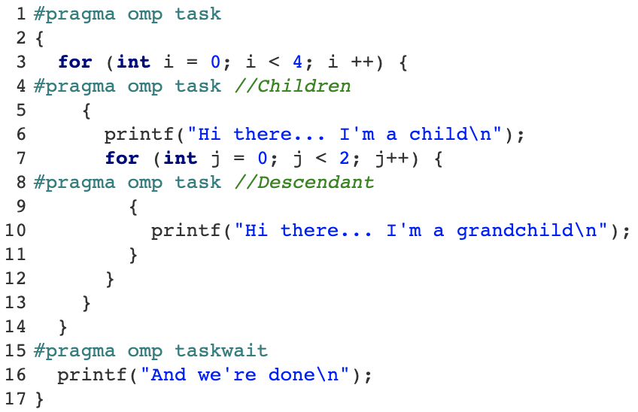
Task Synchronization
Taskwait
Taskwait
Taskwait yields the current task to wait for the completion of only the children task

Slide 37
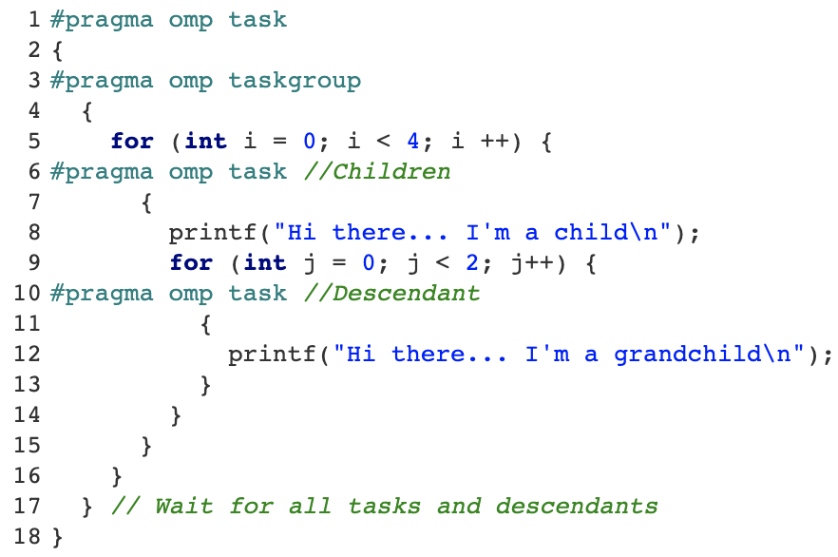
Task Synchronization
Taskgroup
Taskgroup
Taskgroup yields the current task to wait for the completion of all the children task and descendants

Slide 38
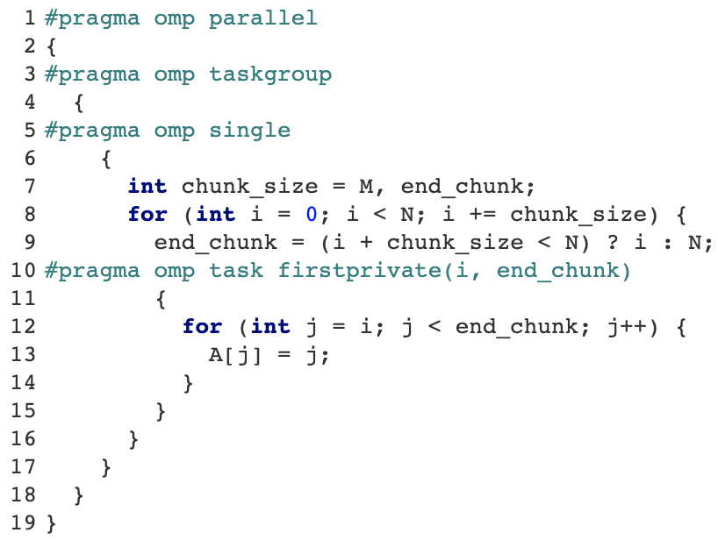
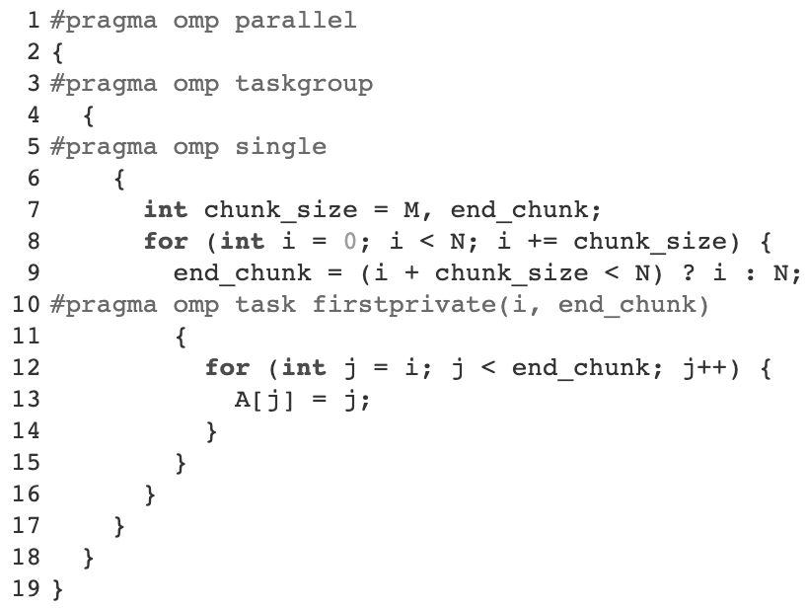

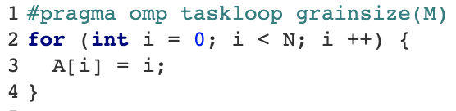
Task loops
New in OpenMP 4.5
Parallelizing this loop with tasks
Taskloops
Allows distributing an iteration loop into multiple tasks
No taskloops

Slide 39
Support in compilers
Implementations are moving fast
Compiler name | OMP Flag | Offloading Flag | Supported Architectures
GCC | -fopenmp | -foffload=<arch>=<options> | KNL, NVIDIA, soon-AMD
LLVM | -fopenmp | -fopenmp-target=<arch> -Xopenmp-target=<options> | NVIDIA
IBM XL | -qsmp=omp | -qoffload | NVIDIA
CRAY CCE | -homp | Not needed | NVIDIA
PGI | -mp |  | Not supported yet – In progress
Intel | -qopenmp | -qopenmp-offload=<arch> | KNL(MIC)
AMD (aomp) | -fopenmp | -fopenmp-target=<arch> -Xopenmp-target=<options> | NVIDIA, AMD

Slide 40

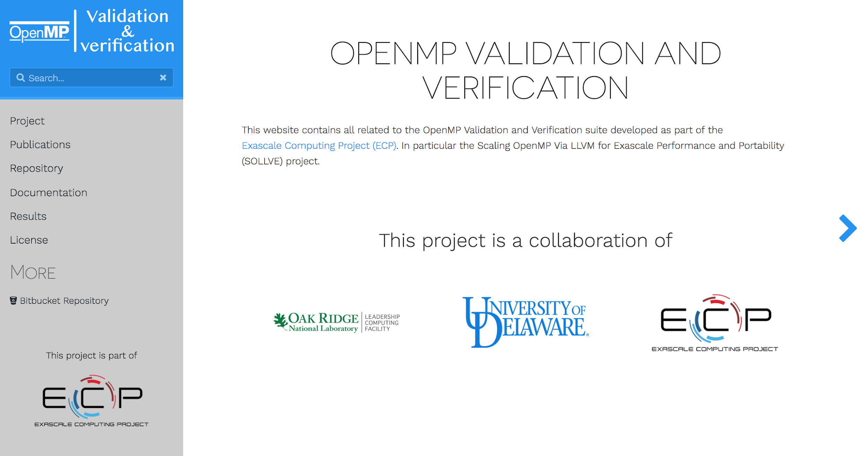
The OpenMP SOLLVE Team Validation and Verification
Help us improve the OpenMP Implementations
Contact information:
Jose Monsalve (josem@udel.edu)
Swaroop Pophale (pophaless@ornl.gov)
Kyle Friedline (utimatu@udel.edu)
Oscar Hernandez (oscar@ornl.gov)
Sunita Chandrasekaran (schandra@udel.edu)
Visit our website
https://crpl.cis.udel.edu/ompvvsollve/
Work supported by the U.S. Department of Energy, Office of Science, the Exascale Computing Project (17-SC-20-SC), a collaborative effort of the U.S. Department of Energy Office of Science and the National Nuclear Security Administration under contract number DE-AC05-00OR22725.
We also thank all of those who directly or indirectly have help this project.

